Slide 1
Two-way fixed-effect models
Difference in difference

Slide 2
Two-way fixed effects
Balanced panels
i=1,2,3….N groups
t=1,2,3….T observations/group
Easiest to think of data as varying across states/time
Write model as single observation
Y_{it}=α + X_{it}β + u_{i} + v_{t} +ε_{it}
X_{it} is (1 x k) vector

Slide 3
Three-part error structure
u_{i} – group fixed-effects. Control for permanent differences between groups
v_{t} – time fixed effects. Impacts common to all groups but vary by year
ε_{it} -- idiosyncratic error

Slide 4
Current excise tax rates
Low: SC($0.07), MO ($0.17), VA($0.30)
High: RI ($3.46), NY ($2.75); NJ($2.70)
Average of $1.32 across states
Average in tobacco producing states: $0.40
Average in non-tobacco states, $1.44
Average price per pack is $5.12

Slide 5
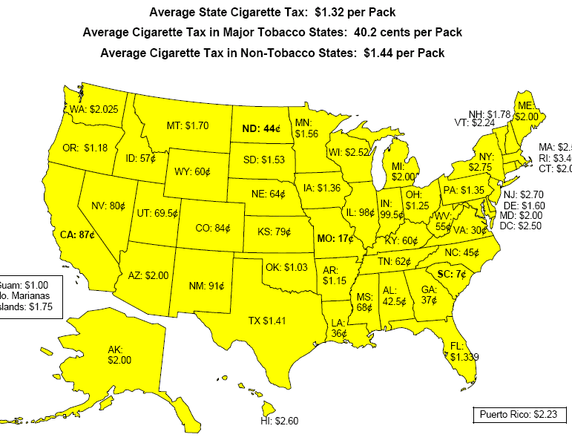

Slide 6
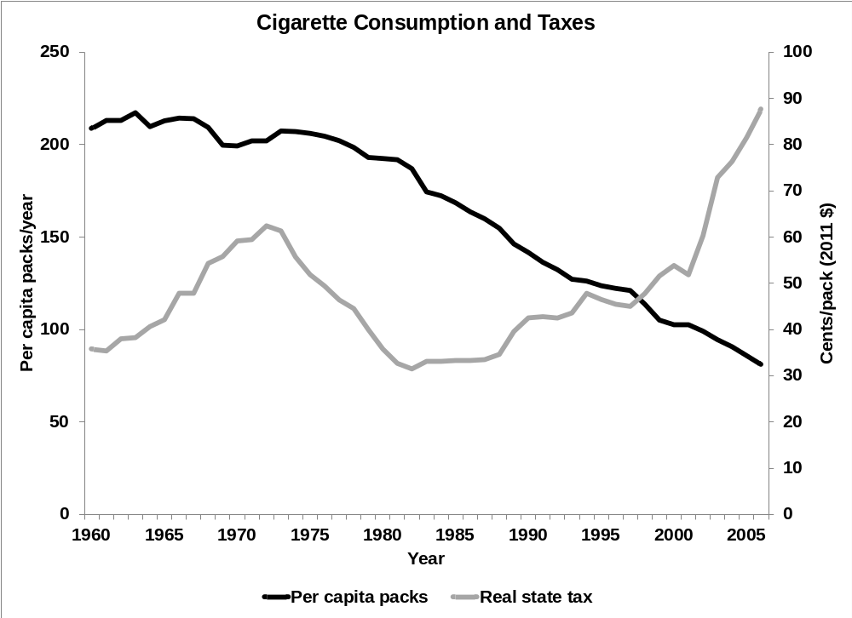

Slide 7
Do taxes reduce consumption?
Law of demand
  Fundamental result of micro economic theory
  Consumption should fall as prices rise
  Generated from a theoretical model of consumer choice
Thought by economists to be fairly universal in application
Medical/psychological view – certain goods not subject to these laws

Slide 8
Starting in 1970s, several authors began to examine link between cigarette prices and consumption
Simple research design
  Prices typically changed due to state/federal tax hikes
  States with changes are ‘treatment’
  States without changes are control

Slide 9
Near universal agreement in results
  10% increase in price reduces demand by 4%
  Change in smoking evenly split between
    Reductions in number of smokers
    Reductions in cigs/day among remaining smokers
Results have been replicated
  in other countries/time periods, variety of statistical models, subgroups
  For other addictive goods: alcohol, cocaine, marijuana, heroin, gambling

Slide 10
Taxes now an integral part of antismoking campaigns
Key component of ‘Master Settlement’
Surgeon General’s report
  “raising tobacco excise taxes is widely regarded as one of the most effective tobacco prevention and control strategies.”
Tax hikes are now designed to reduce smoking

Slide 11
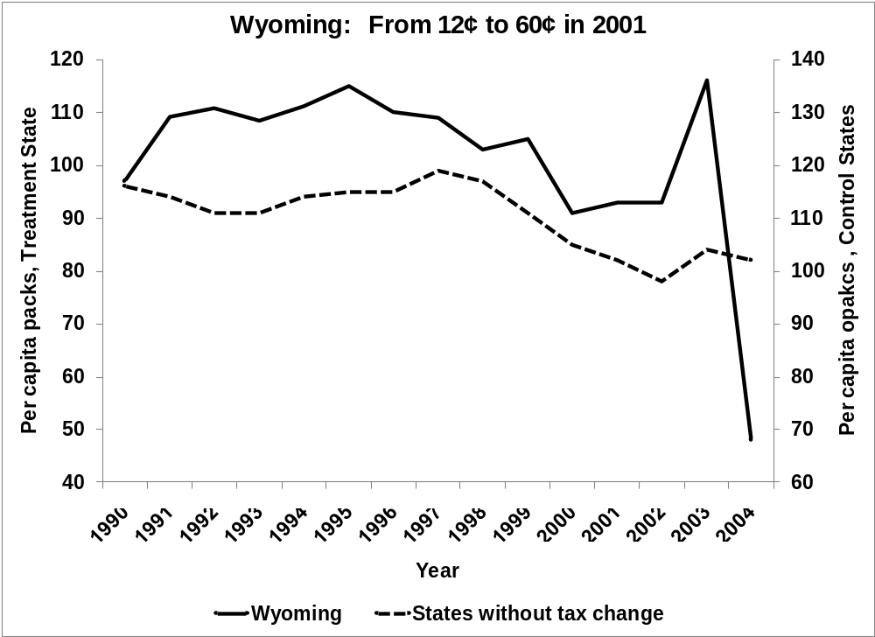

Slide 12
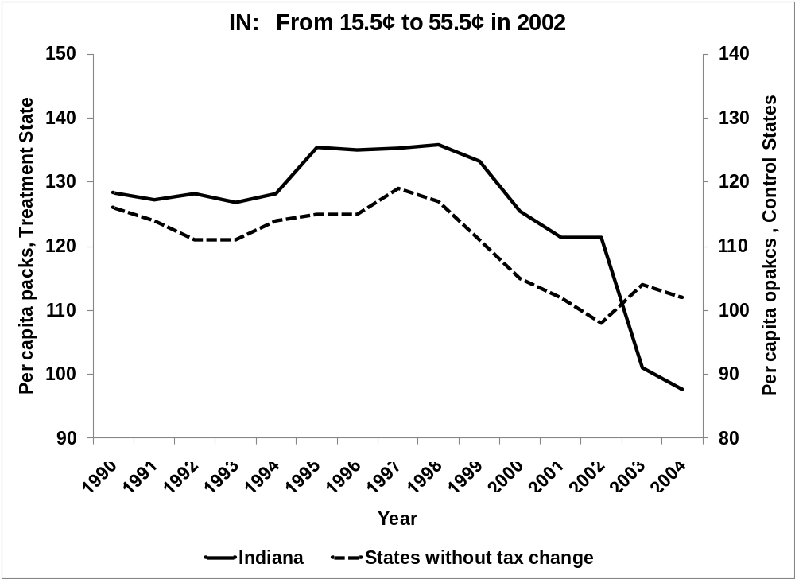

Slide 13
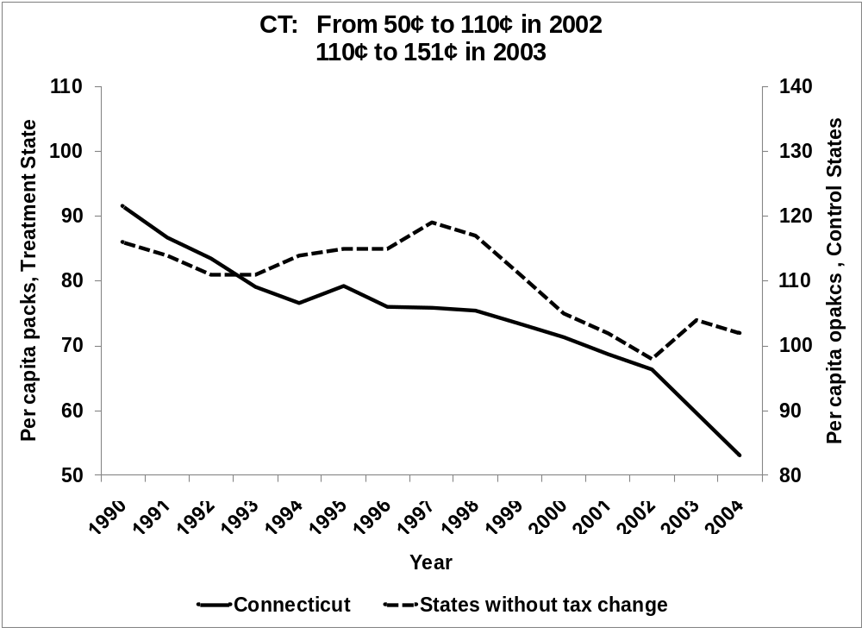

Slide 14
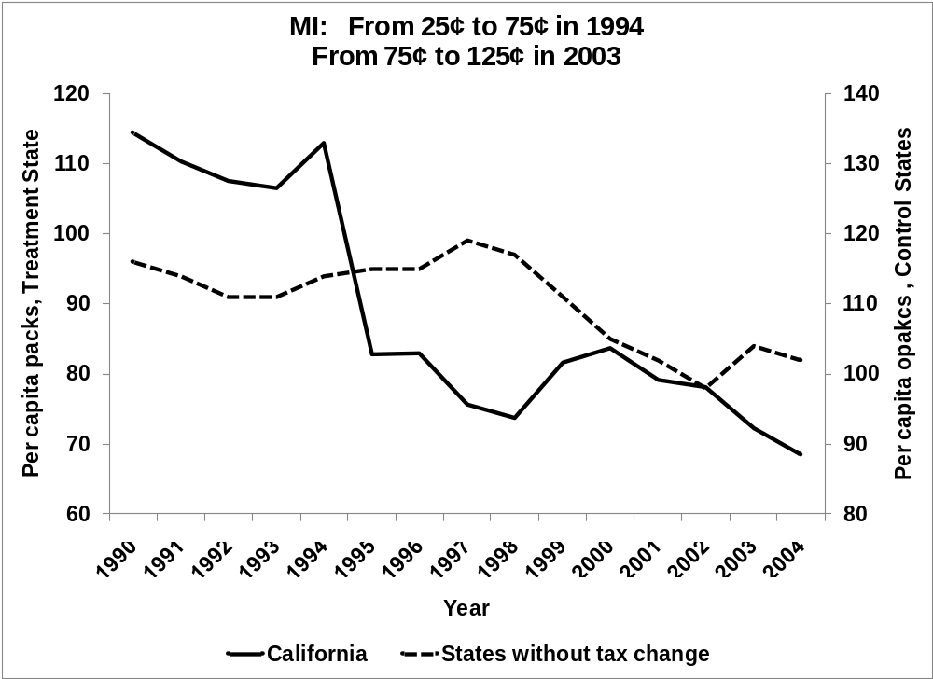

Slide 15
Caution
In balanced panel, two-way fixed-effects equivalent to subtracting
  Within group means
  Within time means
  Adding sample mean
Only true in balanced panels
If unbalanced, need to do the following

Slide 16
Can subtract off means on one dimension (i or t)
But need to add the dummies for the other dimension

Slide 17
* generate real taxes
gen s_f_rtax=(state_tax+federal_tax)/cpi
label var s_f_rtax "state+federal real tax on cigs, cents/pack"
* real per capita income
gen ln_pcir=ln(pci/cpi)
label var ln_pcir "ln of real real per capita income"
* generate ln packs_pc
gen ln_packs_pc=ln(packs_pc)
* construct state and year effects
xi i.state i.year

Slide 18
* run two way fixed effect model by brute force
* covariates are real tax and ln per capita income
reg ln_packs_pc _I* ln_pcir s_f_rtax
* now be more elegant take out the state effects by areg
areg ln_packs_pc _Iyear* ln_pcir s_f_rtax, absorb(state)
* for simplicity, redefine variables as y x1 (ln_pcir)
* x2 (s-f_rtax)
gen y=ln_packs_pc
gen x1=ln_pcir
gen x2=s_f_rtax

Slide 19
* sort data by state, then get means of within state variables
sort state
by state: egen y_state=mean(y)
by state: egen x1_state=mean(x1)
by state: egen x2_state=mean(x2)
* sort data by state, then get means of within state variables
sort year
by year: egen y_year=mean(y)
by year: egen x1_year=mean(x1)
by year: egen x2_year=mean(x2)

Slide 20
* get sample means
egen y_sample=mean(y)
egen x1_sample=mean(x1)
egen x2_sample=mean(x2)
* generate the devaitions from means
gen y_tilda=y-y_state-y_year+y_sample
gen x1_tilda=x1-x1_state-x1_year+x1_sample
gen x2_tilda=x2-x2_state-x2_year+x2_sample
* the means should be maching zero
sum y_tilda x1_tilda x2_tilda

Slide 21
* run the regression on differenced values
*since means are zero, you should have no constant
* notice that the standard errors are incorrect
* because the model is not counting the 51 state dummies
* and 19 year dummies. The recorded DOF are
* 1020 - 2 = 1018 but it should be 1020-2-51-19=948
* multiply the standard errors by sqrt(1018/948)=1.036262
reg y_tilda x1_tilda x2_tilda, noconstant

Slide 22
. * run two way fixed effect model by brute force
. * covariates are real tax and ln per capita income
. reg ln_packs_pc _I* ln_pcir s_f_rtax
Source | SS df MS Number of obs = 1020
-------------+------------------------------ F( 71, 948) = 226.24
Model | 73.7119499 71 1.03819648 Prob > F = 0.0000
Residual | 4.35024662 948 .004588868 R-squared = 0.9443
-------------+------------------------------ Adj R-squared = 0.9401
Total | 78.0621965 1019 .07660667 Root MSE = .06774
------------------------------------------------------------------------------
ln_packs_pc | Coef. Std. Err. t P>|t| [95% Conf. Interval]
-------------+----------------------------------------------------------------
_Istate_2 | .0926469 .0321122 2.89 0.004 .0296277 .155666
_Istate_3 | .245017 .0342414 7.16 0.000 .1778192 .3122147
Delete results
_Iyear_1998 | -.3249588 .0226916 -14.32 0.000 -.3694904 -.2804272
_Iyear_1999 | -.3664177 .0232861 -15.74 0.000 -.412116 -.3207194
_Iyear_2000 | -.373204 .0255011 -14.63 0.000 -.4232492 -.3231589
ln_pcir | .2818674 .0585799 4.81 0.000 .1669061 .3968287
s_f_rtax | -.0062409 .0002227 -28.03 0.000 -.0066779 -.0058039
_cons | 2.294338 .5966798 3.85 0.000 1.123372 3.465304
------------------------------------------------------------------------------

Slide 23
Source | SS df MS Number of obs = 1020
-------------+------------------------------ F( 2, 1018) = 466.93
Model | 3.99070575 2 1.99535287 Prob > F = 0.0000
Residual | 4.35024662 1018 .004273327 R-squared = 0.4784
-------------+------------------------------ Adj R-squared = 0.4774
Total | 8.34095237 1020 .008177404 Root MSE = .06537
------------------------------------------------------------------------------
y_tilda | Coef. Std. Err. t P>|t| [95% Conf. Interval]
-------------+----------------------------------------------------------------
x1_tilda | .2818674 .05653 4.99 0.000 .1709387 .3927961
x2_tilda | -.0062409 .0002149 -29.04 0.000 -.0066626 -.0058193
------------------------------------------------------------------------------
SE on X1 0.05653*1.036262 = 0.05858
SE on X2 0.0002149*1.036262 = 0.0002227

Slide 24
Difference in difference models
Maybe the most popular identification strategy in applied work today
Attempts to mimic random assignment with treatment and “comparison” sample
Application of two-way fixed effects model

Slide 25
Problem set up
Cross-sectional and time series data
One group is ‘treated’ with intervention
Have pre-post data for group receiving intervention
Can examine time-series changes but, unsure how much of the change is due to secular changes

Slide 26
Y
True effect = Y_{t2}-Y_{t1}
Estimated effect = Y_{b}-Y_{a}
Y_{t1}
Y_{a}
Y_{b}
Y_{t2}
t₁
t_{i}
t₂
time

Slide 27
Intervention occurs at time period t₁
True effect of law
  Y_{a} – Y_{b}
Only have data at t₁ and t₂
  If using time series, estimate Y_{t1} – Y_{t2}
Solution?

Slide 28
Difference in difference models
Basic two-way fixed effects model
  Cross section and time fixed effects
Use time series of untreated group to establish what would have occurred in the absence of the intervention
Key concept: can control for the fact that the intervention is more likely in some types of states

Slide 29
Three different presentations
Tabular
Graphical
Regression equation

Slide 30
Difference in Difference
 | Before Change | After Change | Difference
Group 1 (Treat) | Y_{t1} | Y_{t2} | ΔY_{t} = Y_{t2}-Y_{t1}
Group 2 (Control) | Y_{c1} | Y_{c2} | ΔY_{c} =Y_{c2}-Y_{c1}
Difference |  |  | ΔΔY ΔY_{t} – ΔY_{c}

Slide 31
Y
Treatment effect=
(Y_{t2}-Y_{t1}) – (Y_{c2}-Y_{c1})
Y_{c1}
Y_{t1}
Y_{c2}
Y_{t2}
control
treatment
t₁
t₂
time

Slide 32
Key Assumption
Control group identifies the time path of outcomes that would have happened in the absence of the treatment
In this example, Y falls by Y_{c2}-Y_{c1} even without the intervention
Note that underlying ‘levels’ of outcomes are not important (return to this in the regression equation)

Slide 33
Y
Y_{c1}
Treatment effect=
(Y_{t2}-Y_{t1}) – (Y_{c2}-Y_{c1})
Y_{c2}
Y_{t1}
control
Y_{t2}
Treatment
Effect
treatment
t₁
t₂
time

Slide 34
In contrast, what is key is that the time trends in the absence of the intervention are the same in both groups
If the intervention occurs in an area with a different trend, will under/over state the treatment effect
In this example, suppose intervention occurs in area with faster falling Y

Slide 35
Y
Estimated treatment
Y_{c1}
Y_{t1}
Y_{c2}
True treatment effect
control
Y_{t2}
True
Treatment
Effect
treatment
t₁
t₂
time

Slide 36
Basic Econometric Model
Data varies by
  state (i)
  time (t)
  Outcome is Y_{it}
Only two periods
Intervention will occur in a group of observations (e.g. states, firms, etc.)

Slide 37
Three key variables
  T_{it} =1 if obs i belongs in the state that will eventually be treated
  A_{it} =1 in the periods when treatment occurs
  T_{it}A_{it} -- interaction term, treatment states after the intervention
Y_{it} = β₀ + β₁T_{it} + β₂A_{it} + β₃T_{it}A_{it} + ε_{it}

Slide 38
Y_{it} = β₀ + β₁T_{it} + β₂A_{it} + β₃T_{it}A_{it} + ε_{it}
 | Before Change | After Change | Difference
Group 1 (Treat) | β₀+ β₁ | β₀+ β₁+ β₂+ β₃ | ΔY_{t} = β₂+ β₃
Group 2 (Control) | β₀ | β₀+ β₂ | ΔY_{c} = β₂
Difference |  |  | ΔΔY = β₃

Slide 39
More general model
Data varies by
  state (i)
  time (t)
  Outcome is Y_{it}
Many periods
Intervention will occur in a group of states but at a variety of times

Slide 40
u_{i} is a state effect
v_{t} is a complete set of year (time) effects
Analysis of covariance model
Y_{it} = β₀ + β₃ T_{it}A_{it} + u_{i} + v_{t} + ε_{it}

Slide 41
What is nice about the model
Suppose interventions are not random but systematic
  Occur in states with higher or lower average Y
  Occur in time periods with different Y’s
This is captured by the inclusion of the state/time effects – allows covariance between
  u_{i} and T_{it}A_{it}
  v_{t} and T_{it}A_{it}

Slide 42
Group effects
  Capture differences across groups that are constant over time
Year effects
  Capture differences over time that are common to all groups

Slide 43
Meyer et al.
Workers’ compensation
  State run insurance program
  Compensate workers for medical expenses and lost work due to on the job accident
Premiums
  Paid by firms
  Function of previous claims and wages paid
Benefits -- % of income w/ cap

Slide 44
Typical benefits schedule
  Min( pY,C)
  P=percent replacement
  Y = earnings
  C = cap
  e.g., 65% of earnings up to $400/week

Slide 45
Concern:
  Moral hazard. Benefits will discourage return to work
Empirical question: duration/benefits gradient
Previous estimates
  Regress duration (y) on replaced wages (x)
Problem:
  given progressive nature of benefits, replaced wages reveal a lot about the workers
  Replacement rates higher in higher wage states

Slide 46
Y_{i} = X_{i}β + αR_{i} + ε_{i}
Y (duration)
R (replacement rate)
Expect α > 0
Expect Cov(R_{i}, ε_{i})
  Higher wage workers have lower R and higher duration (understate)
  Higher wage states have longer duration and longer R (overstate)

Slide 47
Solution
Quasi experiment in KY and MI
Increased the earnings cap
  Increased benefit for high-wage workers
    (Treatment)
  Did nothing to those already below original cap (comparison)
Compare change in duration of spell before and after change for these two groups

Slide 48
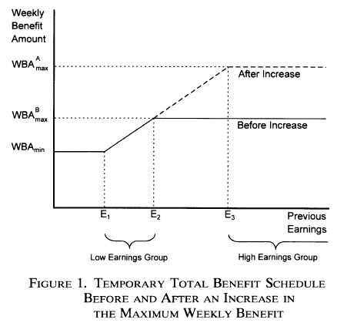

Slide 49
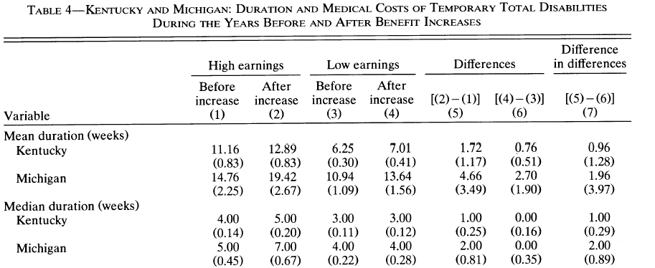

Slide 50
Model
Y_{it} = duration of spell on WC
A_{it} = period after benefits hike
H_{it} = high earnings group (Income>E₃)
Y_{it} = β₀ + β₁H_{it} + β₂A_{it} + β₃A_{it}H_{it} + β₄X_{it}’ + ε_{it}
Diff-in-diff estimate is β₃

Slide 51
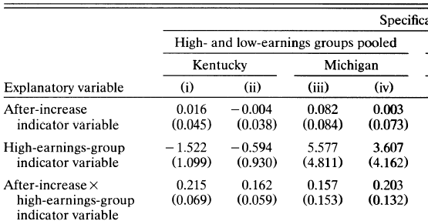

Slide 52
Questions to ask?
What parameter is identified by the quasi-experiment? Is this an economically meaningful parameter?
What assumptions must be true in order for the model to provide and unbiased estimate of β₃?
Do the authors provide any evidence supporting these assumptions?

Slide 53
Tyler et al.
Impact of GED on wages
General education development degree
Earn a HS degree by passing an exam
Exam pass rates vary by state
Introduced in 1942 as a way for veterans to earn a HS degree
Has expanded to the general public

Slide 54
In 1996, 760K dropouts attempted the exam
Little human capital generated by studying for the exam
Really measures stock of knowledge
However, passing may ‘signal’ something about ability

Slide 55
Identification strategy
Use variation across states in pass rates to identify benefit of a GED
High scoring people would have passed the exam regardless of what state they lived in
Low scoring people are similar across states, but on is granted a GED and the other is not

Slide 56
NY
CT
A
B
Passing score NY
Increasing scores
C
D
Passing Scores CT
E
F

Slide 57
Groups A and B pass in either state
Group D passes in CT but not in NY
Group C looks similar to D except it does not pass

Slide 58
What is impact of passing the GED
Y_{is}=earnings of person i in state s
L_{is} = earned a low score
CT_{is} = 1 if live in a state with a generous passing score
Y_{is} = β₀ + L_{is}β₁ + CTβ₂ + L_{is}CT_{is} β₃ + ε_{is}

Slide 59
Difference in Difference
 | CT | NY | Difference
Test score is low | D | C | (D-C)
Test score is high | B | A | (B-A)
Difference |  |  | (D-C) – (B-A)

Slide 60
How do you get the data
From ETS (testing agency) get social security numbers (SSN) of test takes, some demographic data, state, and test score
Give Social Security Admin. a list of SSNs by group (low score in CT, high score in NY)
SSN gives you back mean, std.dev. # obs
per cell

Slide 61

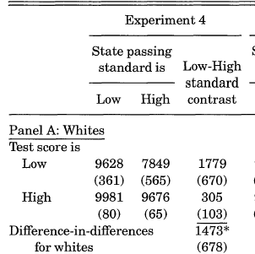

Slide 62
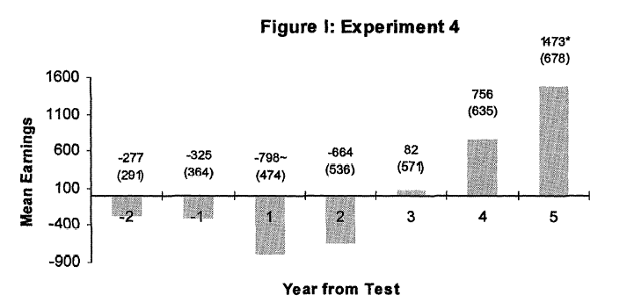

Slide 63
More general model
Many within group estimators that do not have the nice discrete treatments outlined above are also called difference in difference models
Cook and Tauchen. Examine impact of alcohol taxes on heavy drinking
States tax alcohol vary over time
Examine impact on consumption and results of heavy consumption death due to liver cirrhosis

Slide 64
Y_{it} = β₀ + β₁ INC_{it} + β₂ INC_{it-1}
+ β₁ TAX_{it} + β₂ TAX_{it-1} + u_{i} + v_{t} + ε_{it}
i is state, t is year
Y_{it} is per capita alcohol consumption
INC is per capita income
TAX is tax paid per gallon of alcohol

Slide 65
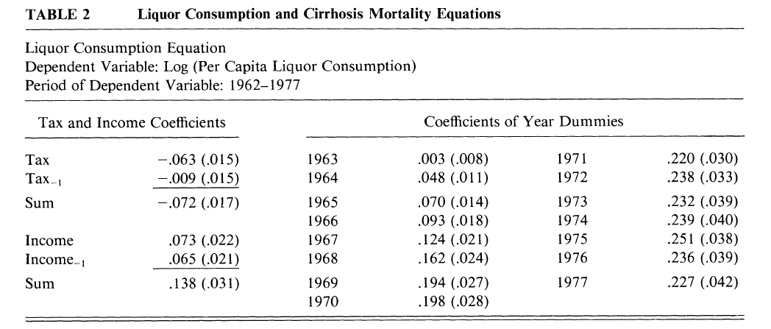

Slide 66
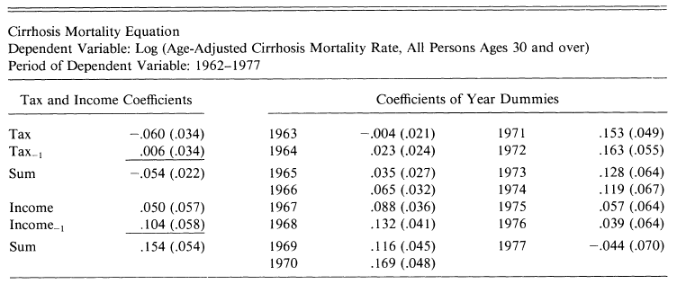

Slide 67
Some Keys
Model requires that untreated groups provide estimate of baseline trend would have been in the absence of intervention
Key – find adequate comparisons
If trends are not aligned, cov(T_{it}A_{it},ε_{it}) ≠0
  Omitted variables bias
How do you know you have adequate comparison sample?

Slide 68
Do the pre-treatment samples look similar
  Tricky. D-in-D model does not require means match – only trends.
  If means match, no guarantee trends will
  However, if means differ, aren’t you suspicious that trends will as well?

Slide 69
Develop tests that can falsify model
Y_{it} = β₀ + β₃ T_{it}A_{it} + u_{i} + v_{t} + ε_{it}
Will provide unbiased estimate so long as cov(T_{it}A_{it}, ε_{it})=0
Concern: suppose that the intervention is more likely in a state with a different trend
If true, coefficient may ‘show up’ prior to the intervention

Slide 70
Add “leads” to the model for the treatment
Intervention should not change outcomes before it appears
If it does, then suspicious that covariance between trends and intervention

Slide 71
Y_{it} = β₀ + β₃ T_{it}A_{it} + α₁T_{it}A_{it+1} + α₂ T_{it}A_{it+2} + α₃T_{it}A_{it+3} + u_{i} + v_{t} + ε_{it}
Three “leads”
Test null: H_{o}: α₁=α₂=α₃=0

Slide 72
Grinols and Mustard
Impact of a casino opening on crime rates
Concern: casinos are not random – opened in struggling areas
Data at county/year level – simple dummy that equals 1 in year of intervention, =0 otherwise

Slide 73
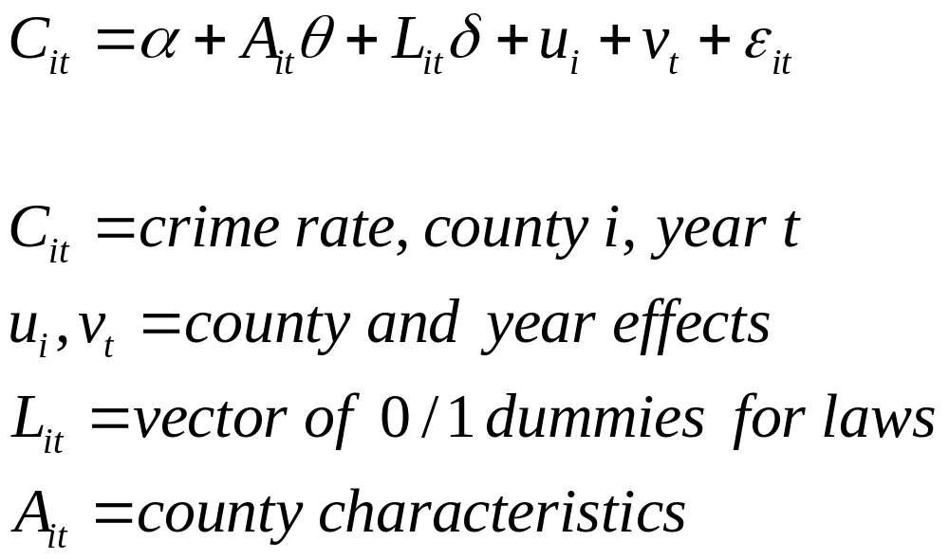

Slide 74
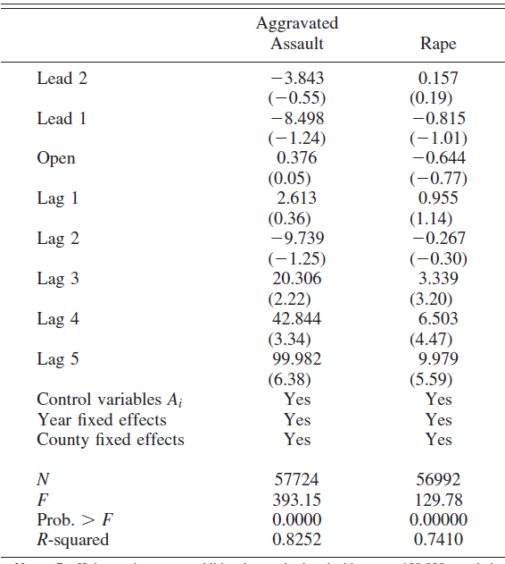
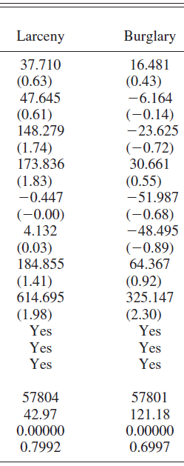

Slide 75
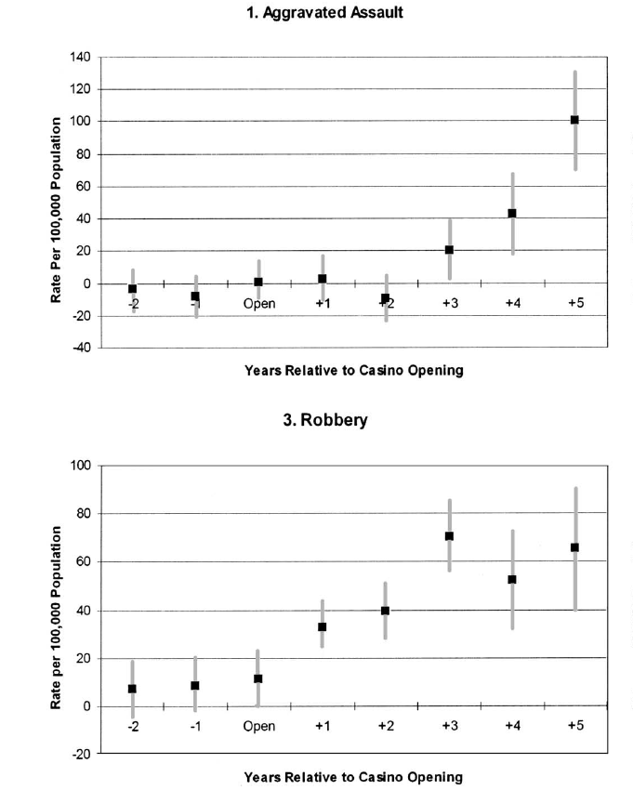

Slide 76
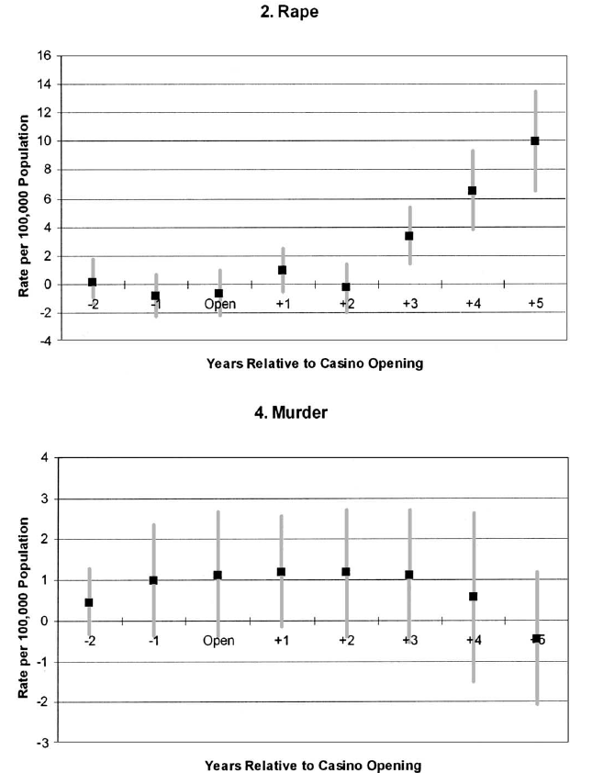

Slide 77
Pick control groups that have similar pre-treatment trends
Most studies pick all untreated data as controls
  Example: Some states raise cigarette taxes. Use states that do not change taxes as controls
  Example: Some states adopt welfare reform prior to TANF. Use all non-reform states as controls
Intuitive but not likely correct

Slide 78
Can use econometric procedure to pick controls
Appealing if interventions are discrete and few in number
Easy to identify pre-post

Slide 79
Card and Sullivan
Examine the impact of job training
Some men are treated with job skills, others are not
Most are low skill men, high unemployment, frequent movement in and out of work
Eight quarters of pre-treatment data for treatment and controls

Slide 80
Let Y_{it} =1 if “i” worked in time t
There is then an eight digit sequence of outcomes
“11110000” or “10100111”
Men with same 8 digit pre-treatment sequence will form control for the treated
People with same pre-treatment time series are ‘matched’

Slide 81
Intuitively appealing and simple procedure
Does not guarantee that post treatment trends would be the same but, this is the best you have.

Slide 82
More systematic model
Data varies by individual (i), state (s), time
Intervention is in a particular state
Y_{ist} = β₀ + X_{ist} β₂+ β₃ T_{st}A_{st} + u_{s} + v_{t} + ε_{ist}
Many states available to be controls
How do you pick them?

Slide 83
Restrict sample to pre-treatment period
State 1 is the treated state
State k is a potential control
Run data with only these two states
Estimate separate year effects for the treatment state
If you cannot reject null that the year effects are the same, use as control

Slide 84
Unrestricted model
Pretreatment years so T_{st}A_{st} not in model
M pre-treatment years
Let W_{t}=1 if obs from year t
Y_{ist} = α₀ + X_{ist} α₂+ Σ_{t=2}γ_{t}W_{t} + Σ_{t=2} λ_{t} T_{i}Wt + u_{s} + ε_{ist}
H_{o}: λ₂= λ₃=… λ_{m}=0

Slide 85

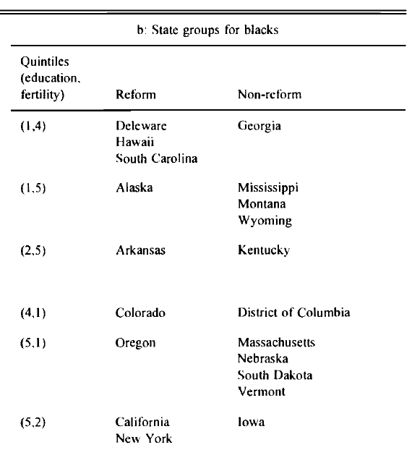

Slide 86
Acemoglu and Angrist
ada_jpe.do
ada_jpe.log

Slide 87
Americans with Disability Act
Requires that employers accommodate disabled workers
Outlaws discrimination based on disabilities
Passes in July 1990, effective July 1992
May discourage employment of disabled
  Costs of accommodations
  Maybe more difficult to fire disabled

Slide 88
Econometric model
Difference in difference
Have data before/after law goes into effect
Treated group – disabled
Control – non-disabled
Treatment variable is interaction
  Diabled * 1992 and after

Slide 89
Y_{it} = X_{it}π + D_{i}δ + Year_{t}γ_{t} + Year_{t} D_{it}α_{t} + ε_{it}
Y_{it} = labor market outcome, person i year t
X_{it} vector of individual characteristics
D_{it} =1 if disableld
Year_{t} = year effect
Year_{t} D_{it} = complete set of year x disability interactions

Slide 90
Coef on α_{i}’s should be zero before the law
May be non zero for years>=1992

Slide 91
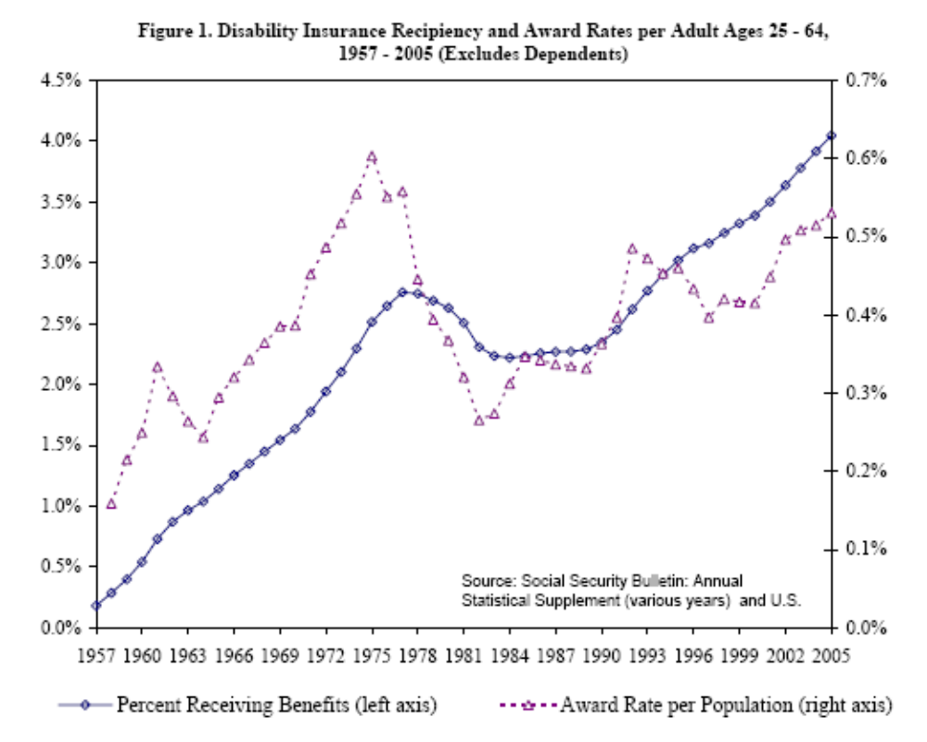

Slide 92
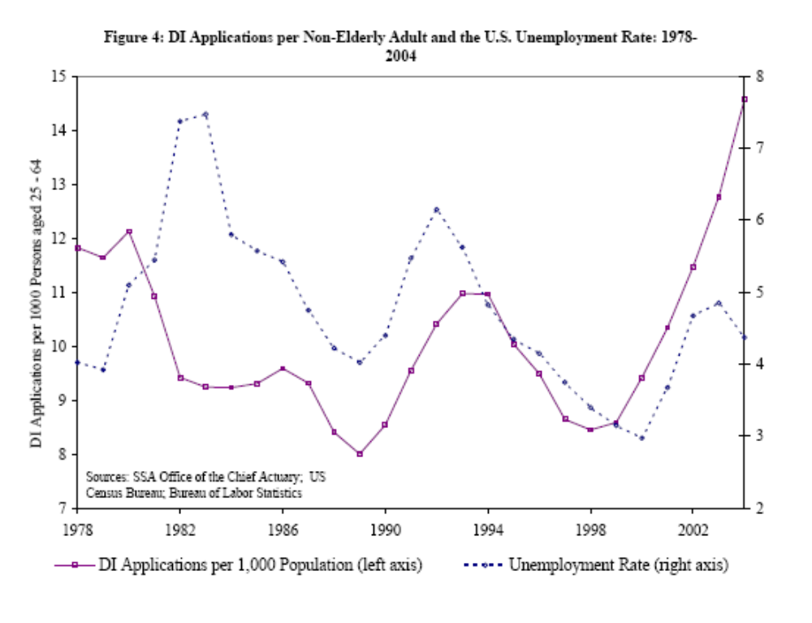

Slide 93
Data
March CPS
Asks all participants employment/income data for the previous year
  Earnings, weeks worked, usual hours/week
Data from 1988-1997 March CPS
  Data for calendar years 1987-1996
Men and women, aged 21-58
Generate results for various subsamples

Slide 94
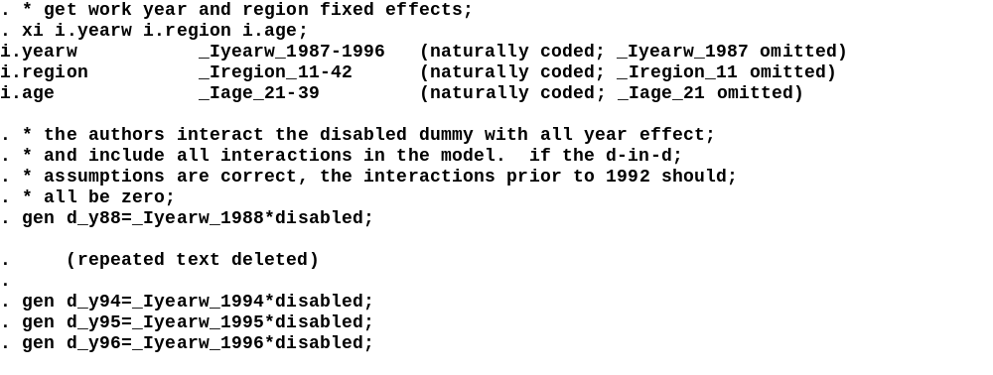
Constructs sets of dummies
For year, region and age
Generate year x Disability
interactions

Slide 95
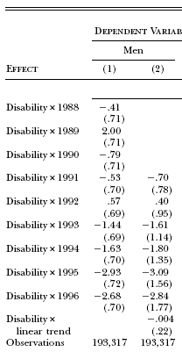
Table 2
ADA not in effect
Effective years of ADA

Slide 96
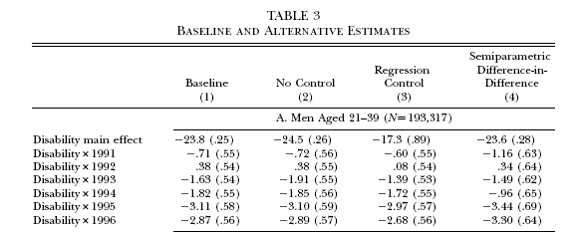
Model with few
controls
After adding extensive list
Of controls, results change
little

Slide 97
reg wkswork1 _Iy* disabled d_y*;
Include all variables
that begin with d_y
Include all variables
that begin with
_ly

Slide 98
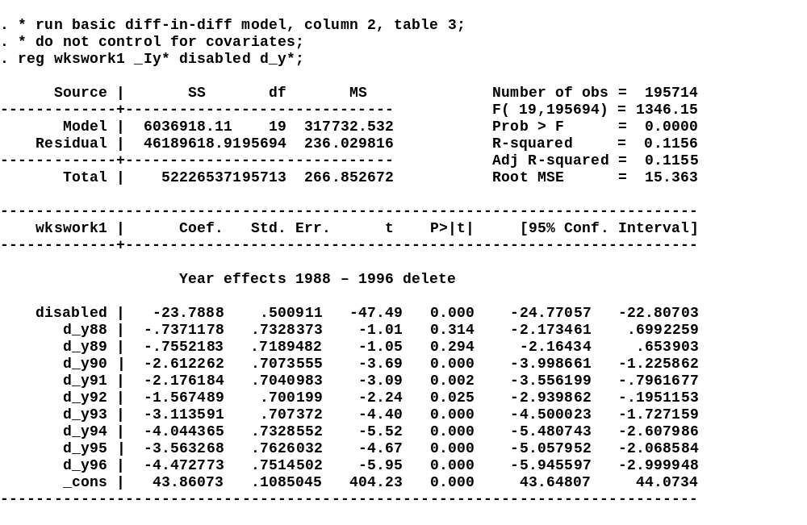
# obs close to what is
Reported in paper
Disability main effect
Disability law
interactions
Need to delete one year effect
Since constant is in model

Slide 99
Run different model
One treatment variable: Disabled x after 1991
. gen ada=yearw>=1992;
. gen treatment=ada*disabled;
Add year effects to model, disabled, them ADA x disabled interaction

Slide 100
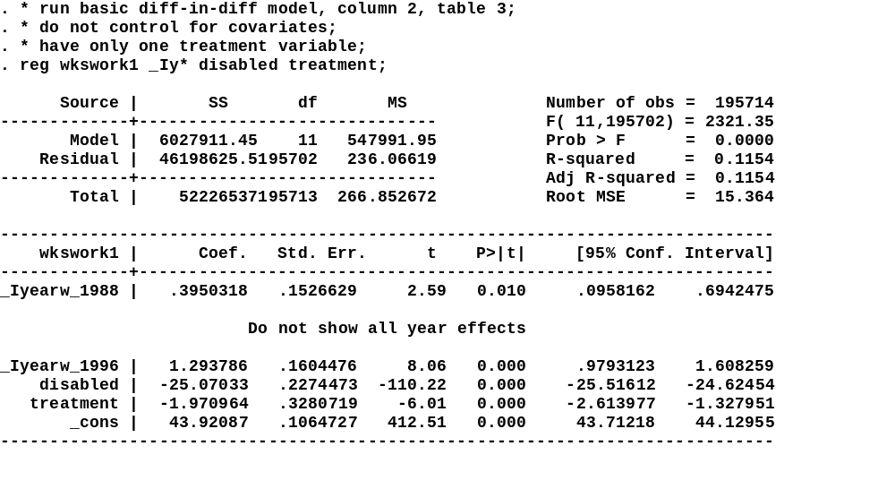
Regression statement
ADA reduced work by almost 2 weeks/year

Slide 101
Should you cluster?
Intervention varies by year/disability
Should be within-year correlation in errors
People are in the sample two years in a row so there should be some correlation over time
Cannot cluster on years since # groups too small

Slide 102
Need larger set that makes sense
Two options (many more)
  Cluster on state
  Cluster on state/disability

Slide 103
. gen disabled_state=100*disabled+statefip;
reg wkswork1 _Ia* _Iy* _Ir* white black hispanic lths hsgrad somecol disabled treatment, cluster(statefip);
.reg wkswork1 _Ia* _Iy* _Ir* white black hispanic lths hsgrad somecol disabled treatment, cluster(disabled_state);

Slide 104
Summary of results for cluster
Coefficient on treatment (standard error)
  Regular OLS -1.998 (0.315)
  Cluster by state: -1.998 (0.487)
  Cluster by state/disab. -1.998 (0.532)

Slide 105
Dranove et al.

Slide 106
Introduction
Increased use of report cards, especially in health care and education
Two best examples:
  NCLB legislation for education
  NY’s publication of coronary artery bypass graft (CABG) mortality rates for surgeons and hospitals

Slide 107
Disagreement about usefulness
For: Better informed consumers make better decisions, makes markets more efficient
  Choose best doctors
  Provides incentives for schools and doc’s to improve care
Against
  May give incomplete evidence. Can risk adjust but not on all characteristics
  Doc’s can manipulate rankings by selecting patients with the highest expected success rate, decreasing access to care for the sickest patients

Slide 108
This paper
Uses data on al heart attack patients in Medicare in from 1987-94
Impact of reports cards in NY and PA
Examines three sets of outcomes associated with report cards
  Matching of patients to providers: is there a match of the sickest patients to best providers?
  Incidence and quantity of CABG
    Do total surgeries go up or down?
    Shift to healthier patients?
  Is there a substitution into other forms of treatment NOT measured by the report card?

Slide 109
Report Cards
NY
  Hospital specific, risk adjusted CABG mortality rates based on 1990
  Physician specific rates in 1992
PA – hospital specific data in 1992
Effective dates – impact patient decision making in 1991 (NY) and 1993 (PA) concerning hospitals, 1993 in both states for physicians

Slide 110
Data
Population potentially impacted are those with acute myocardial infarctions (AMI) in Medicare
Easily obtained from Medicare claims data
Large fraction treated with CABG
Selection into the sample unlikely impacted by report cards
Physicians treating AMI likely to have multiple treatment options (e.g., heart cath., medical treatment, etc.)

Slide 111
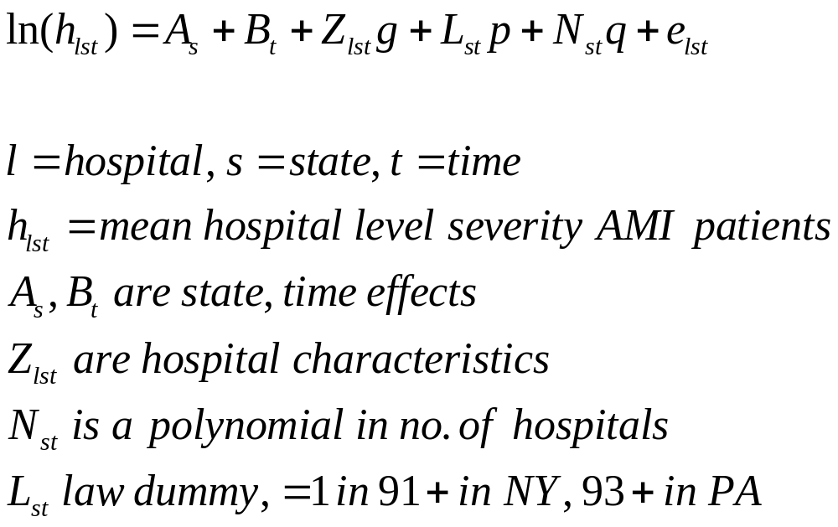
Hospital Model

Slide 112
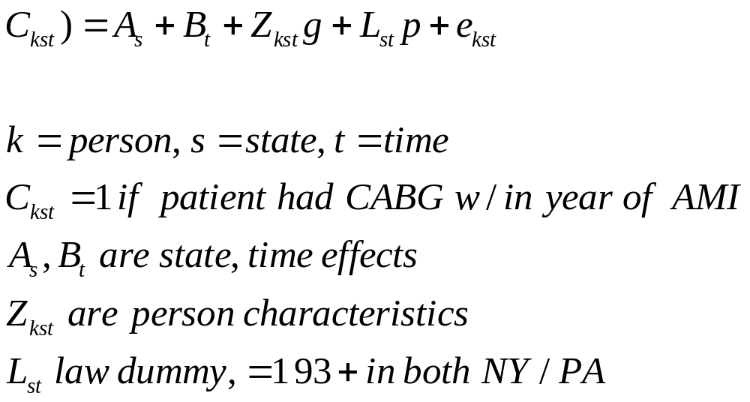
Individual model

Slide 113
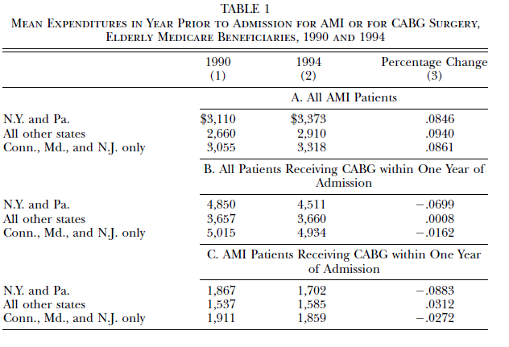

Slide 114
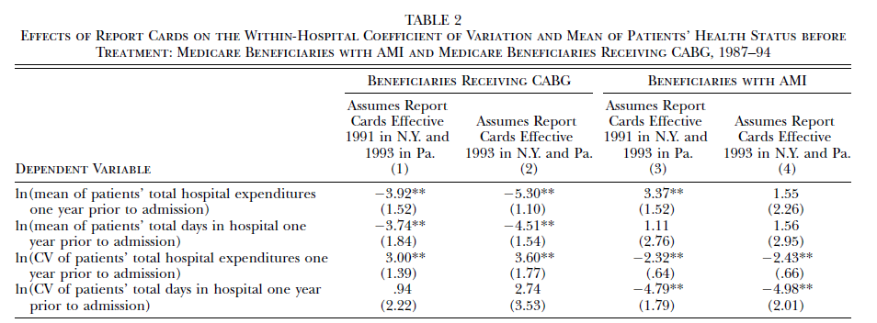

Slide 115
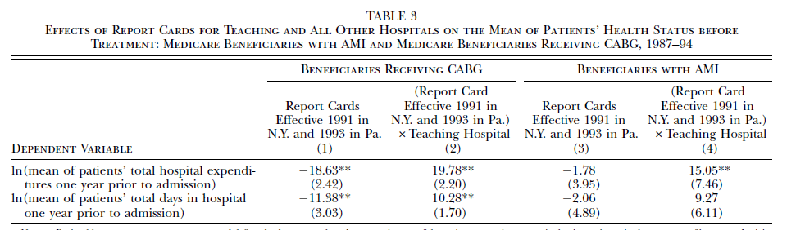

Slide 116
